Slide 1
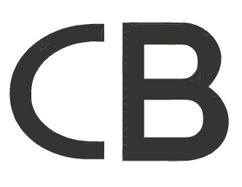
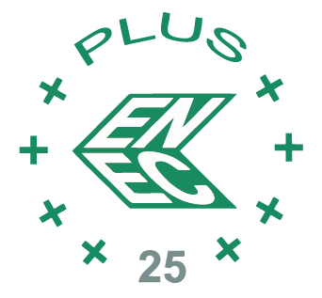



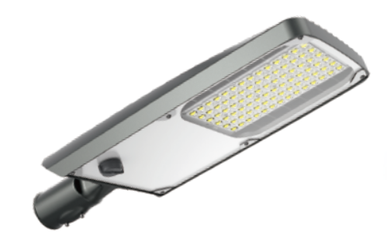
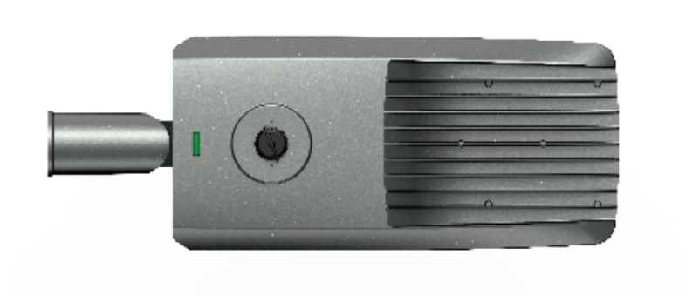
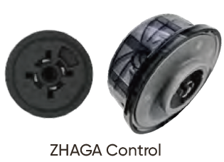
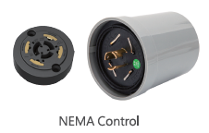
Mola Family LED Street Light
UNI-STF4-(1-3)
Data Sheet - Street Lighting
IK09 IP66
Mola
Standard Color: Dark Grey (PANTONE 8403C). Any other RAL color upon request.
Features
- Mola Rated Power Range: 10W-150W.
- Rated Input Voltage: AC90-305V/AC220-240V,50/60Hz.
- Housing Material: Low copper content die-casting aluminum with toughened heat resistant glass.
- Mola: Cutting-edge tool-free detachable design;
- Protection Rating: IP66 according to IEC 60529, IK09 according to IEC 62262.
- Installation Method: Side entry and Post top entry;
- High brightness and efficient top-tier LEDs.
- CCT available in 2200K/2700K/3000K/4000K/5000K/5700K/6500K.
(Remark : Only 3000K and below CCT comply with Dark Sky standard)
- On/Off or DALI 2 or 0-10V dimmable LED driver. Dark Sky Approved luminaire with dimmable driver option, which adjustable to ≤10% of maximum lumen output.
- Equipped with bubble level ensuring product balanced and safer installation at site.
- Both NEMA and ZHAGA receptacle available for future smart cities integration.
- Built in external 10KV surge protection device, optional 20KV.
- Multiple light distribution curves(Both full cut-off & semi-cut off) for meeting different lighting applications.
- Solar lighting system compatible.
- Control mode: Photo-control, Power line communication (NEMA), NB-IoT(NEMA), Zigbee(NEMA).
- Pole Diameter: Standard Φ60 (Optional Φ42mm and Φ76mm).
- Operating environment : Operating temperature - 40℃ ~ 50℃, Operating humidity :10% ~ 95 % RH, Storage temperature - 40 ℃ ~ 55 ℃.
- Warranty : Standard 5 years, 7 to 10 years available upon request.
01
Tel:+86-0755-29918999 Email:ledlighting@unilumin.com
Web:www.unilumin-lighting.com

Slide 2
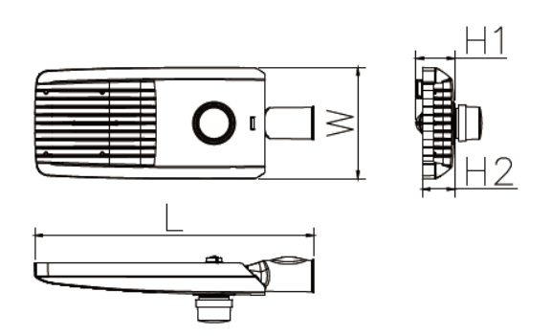
Data Sheet - Street Lighting
Product Dimensions
Product Model | Series Code | Dimensions（mm）
 |  | L | W | H1 | H2
Mola Serial | UNI-STF4-(1-3) | 615.8 | 245.3 | 85.5 | 71
Remark :
This dimension of Mola meets the maximum power of 150W. Other product dimensions can be selected according to the corresponding required power.
Mola
Standard Ordering Matrix
Series Code | Power Level | Distribution / Optics | CCT | Mounting | Paint Finish | Voltage | Options
UNI-STF4-1 UNI-STF4-2 UNI-STF4-3 | 10W-40W 41W-90W 91W-150W | 618/710/711/712/718/719/830/831/870/903/904/906/933/934/994 | 2200K-6500K | Side Entry or Post Top (Adjustable Spigot) | Grey/ Black/ White/ Other RAL Paint options | 90-305V or 220-240v 50/60Hz | NEMA/ZHAGA SPD 10KV or 20KV Dimming Option 0~10V/DALI/DALI2/ CLO/Astrodim
02
Tel:+86-0755-29918999 Email:ledlighting@unilumin.com
Web:www.unilumin-lighting.com

Slide 3
Data Sheet - Street Lighting
Dark Sky Approved Ordering Matrix
Series Code | Power Level | Distribution / Optics | CCT | Mounting | Paint Finish | Voltage | Options
UNI-STF4-1 UNI-STF4-2 UNI-STF4-3 | 10W-40W 41W-90W 91W-150W | 618/710/711/712/718/830/831/904/906 | 2200K 2700K 3000K | Side Entry or Post Top (Fixed Spigot) | Grey/ Black/ White/ Other RAL Paint options | 90-305V or 220-240v 50/60Hz | NEMA/ZHAGA SPD 10KV or 20KV Dimming Option 0-10V/DALI/DALI2/ CLO/Astrodim SSV : Surrounding Shade Visor
02
Tel:+86-0755-29918999 Email:ledlighting@unilumin.com
Web:www.unilumin-lighting.com

Slide 4
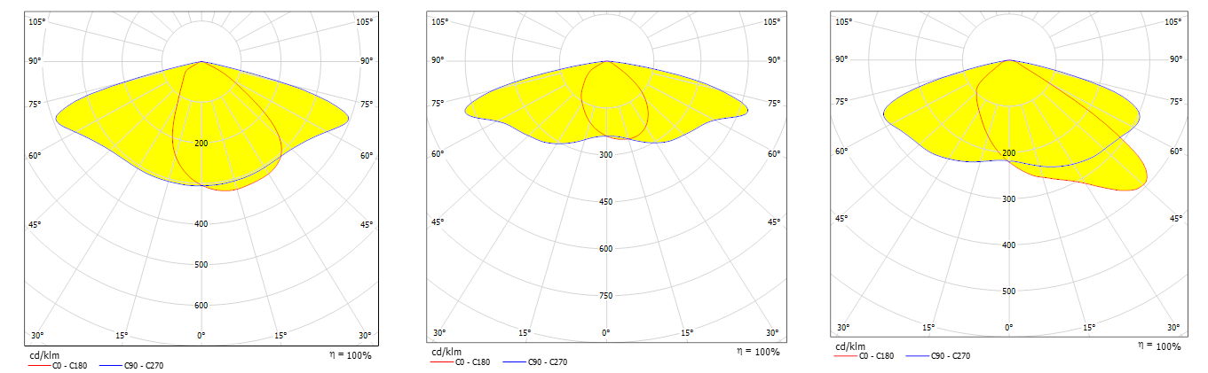
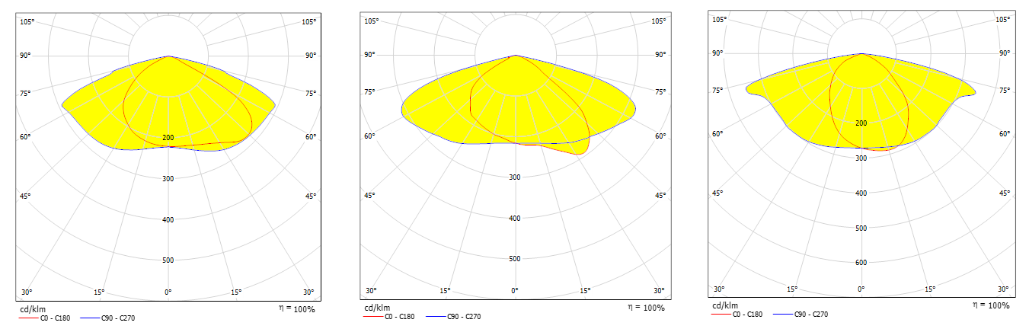
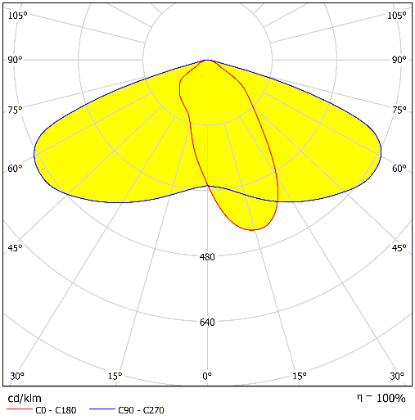
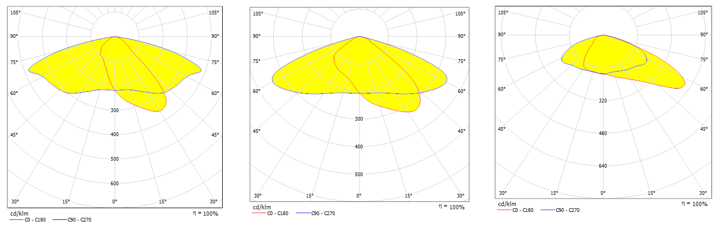
Data Sheet - Street Lighting
Light Distributions Curves
Type ll Short (Optics 618)
Type ll Medium (Optics 710)
Type ll Short (Optics 711)
Type lll Medium (Optics 712)
Type lll Short (Optics 718)
Type l Short (Optics 904)
Type lll Medium (Optics 830)
Type ll Short (Optics 831)
Type lll Short (Optics 906)
Note: The pictures are only the references of typical light distribution type, and the specific parameters shall be subject to the actual IES of the product.
Note: The pictures are only the references of typical light distribution type, and the specific parameters shall be subject to the actual IES of the product.
03
Tel:+86-0755-29918999 Email:ledlighting@unilumin.com
Web:www.unilumin-lighting.com

Slide 5

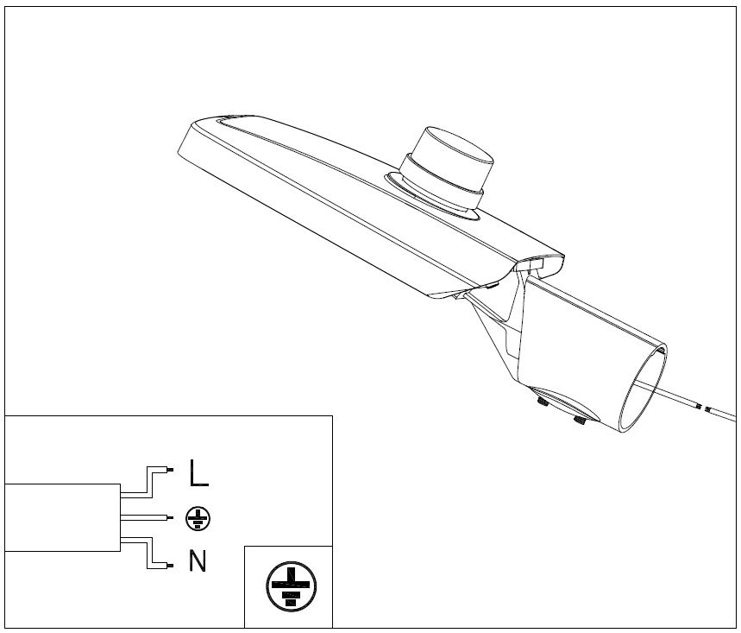
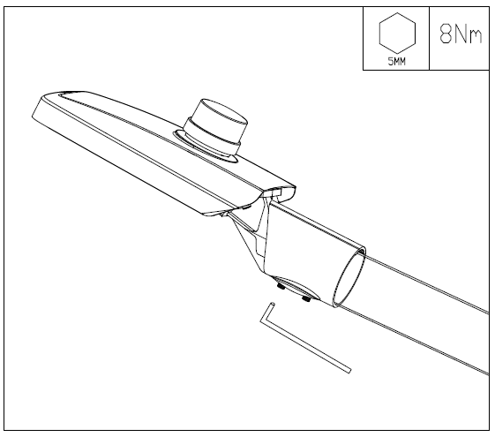
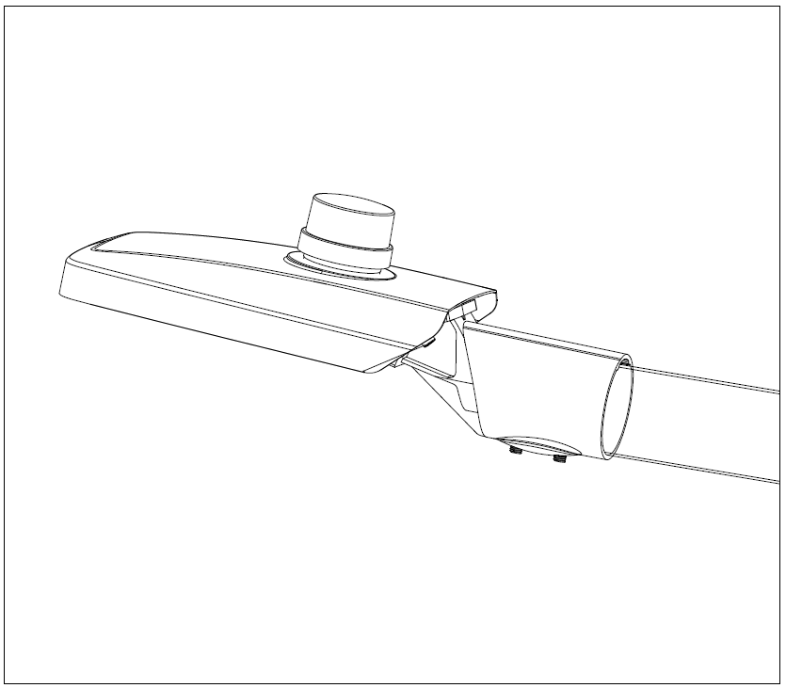
Data Sheet - Street Lighting
Installation Guide
1. Wire the power cables of the luminaire and the pole according to the picture below: L(BRN) live line, N (BLU) neutral line,
(YG/GRN) ground line) , making the connection waterproof.
2. Insert the cantilevered arm of lamp pole into the lamp, and then tighten 2pcs M10 screws.
3. Complete Installation
NEMA socket and matching photocell, short-circuit cap instructions:
The NEMA socket used for streetlight products must meet the locking size requirements of ANSI C136.10 standard and be certified by UL;
The NEMA socket used for streetlights and the accompanying light control photocell and short-circuit cap must meet IP66 testing requirements;
The users must use the NEMA socket model recommended by our company and the matching light control photocell, short-circuit cap:
Without the company's permission, the NEMA socket, light control photocell, and short-circuit cap cannot be replaced at will; The quality risks caused by the change shall be borne by the customer, and the product no longer complies with the warranty terms
The lighting control photocell needs to pass 10KV surge protection test(with 10KV SPD for test)
Non rotatable NEMA socket is priority to use for internal matching, and rotatable NEMA socket can be selected under customer specified conditions
If the product must meet other testing requirements due to product characteristics or other special reasons (such as bidding documents, customer customization requirements, etc.), testing can be conducted according to the actual situation requirements.
*DarkSky Approved mounting options are fixed for side-entry or post top installations and do not allow for adjustment in the field.
Maintenance
- Keep the luminaire in clean and good maintenance to ensure long lifespan and safety use.
- Wipe the luminaire with soft cloth dipped with soapy water (squeeze the water out first), and then make it clean and dry with a new cloth.
- Do not use volatile chemical liquids such as gasoline, alcohol or insecticides to clean the luminaire, otherwise damage occurs.
04
Tel:+86-0755-29918999 Email:ledlighting@unilumin.com
Web:www.unilumin-lighting.com

Slide 6
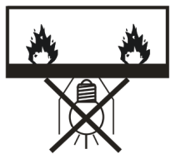

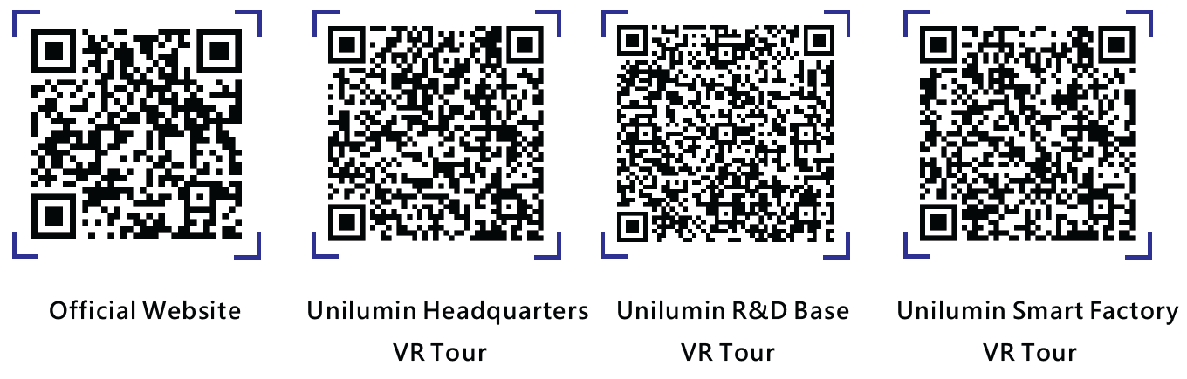
Data Sheet - Street Lighting
Cautions
- Make sure safe and complete installation before power on.
- Do not mount the luminaire onto ordinary combustible materials directly in any circumstances.
- Do not cover the luminaire with any objects.
- Do not use the product in a closed environment.
- The maintenance of the luminaire must be done by professionals.
- The external wiring of the luminaire is Y-shaped. If damaged, shall be replaced with wires provided by the original manufacturer or its service team.
- The light source, if damaged, shall be replaced with chips provided by the manufacturer or service team.
Warning, danger of electric shock
- Statement: The luminaire complies with the non-hazardous requirements in the photo-biological safety standard IEC 62471:2008.
- Product specifications are subject to change without notice.
05
Tel:+86-0755-29918999 Email:ledlighting@unilumin.com
Web:www.unilumin-lighting.com

