Slide 1
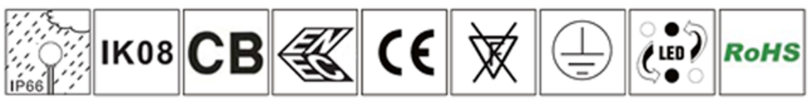
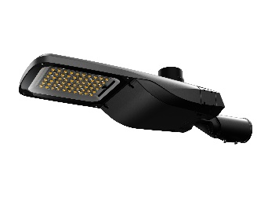
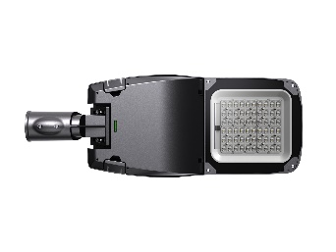
Marlin
Standard Color: Dark Gray (PANTONE:8403C)
Features:
Rated Power Range: 30W-150W;
Rated Input Voltage: AC200-240V;
Housing Material: Die-casting aluminum alloy+ Ultra transparent tempered glass;
Cover opening: Tool-free;
Protection Degree: IP66, IK08;
Angle Adjuster: 20 ° to - -20° angle adjustment for horizontal and vertical installation (5 ° minimum angle adjustment);
Equipped with automatic Power-off switch to ensure safe installation and maintenance.
Equipped with bubble level to ensure quick installation;
NEMA interface and ZHAGA interface are optional;
Control mode: Power line communication (NEMA), NB-IoT(NEMA), ZigBee (NEMA), LoRa (NEMA), power timer dimming, NEMA light switch;
Pole Diameter: Φ60(Φ76mm & Φ42mm are optional );
Operating environment: Operating Temperature - 40℃ ~ 45℃, Operating Humidity10% ~ 90 %RH, Storage Temperature -40 ℃ ~ 55 ℃.

Slide 2
Product Model | UNI-STD4-1-030 | UNI-STD4-2-060 | UNI-STD4-3-090 |  | UNI-STD4-4-120 |  | UNI-STD4-5-150
Power (W) | 30 | 60 | 90 |  | 120 |  | 150
Luminous Flux （lm） | 4800 | 9600 | 14400 |  | 19200 |  | 24000
Power Factor | ≥0.90 | ≥0.90 | ≥0.95 |  | ≥0.95 |  | ≥0.95
Input Voltage | AC200-240V 50/60Hz
LED | Osram/5050
Driver | Osram/Tridonic/Inventronics/Moso
CCT（K） | 3000K/4000K/5000K/5700K/6500K
Luminaire Efficiency@4000K、Ta=25℃ (lm/W) | 160
CRI | 70
Working Temp. | - 40 ℃ ～45 ℃
Working Humidity | 10 % ～ 90 % RH
Storage Temp. | - 40 ℃ ～ 55 ℃
Housing Materials | Die-casting aluminum
IP Grade | IP66
IK Grade | IK08
Life Span (Hrs) | 100,000
Max Projected Area (㎡) | 0.11 | 0.14 |  | 0.14 |  | 0.17 |  | 0.17
Product Dimension (mm) | 574×219×124 | 665×250×125 |  | 665×250×135 |  | 695×285×140 |  | 695×285×140
Packing Dimension (mm) | 610×340×235 | 740×340×235 |  | 740×340×235 |  | 740×400×235 |  | 740×400×235
Net Weight (kg) | 4.0±0.5 | 5.0±0.5 |  | 5.5±0.5 |  | 7.0±0.5 |  | 7.0±0.5
Gross Weight (kg) | 5.0±0.5 | 6.5±0.5 |  | 7.0±0.5 |  | 9.0±0.5 |  | 9.0±0.5
Note: The tolerance of Luminous Flux for lighting products is ±7%

Slide 3
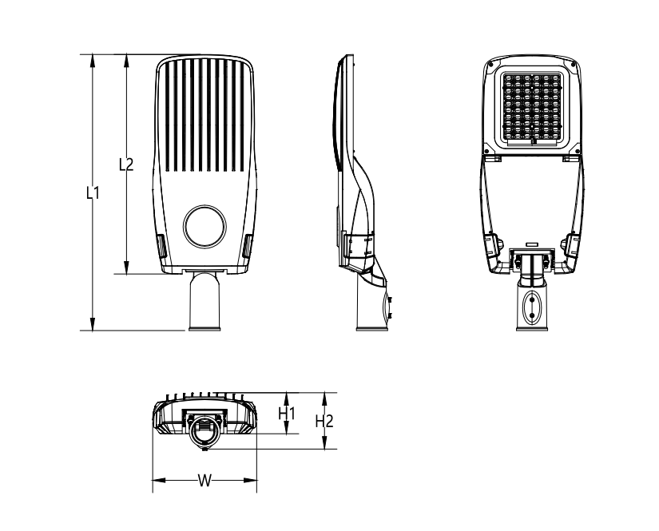
Product Dimension:
Product Model | Dimension（mm）
 | L1 | L2 | W | H1 | H2
STD3-1 | 574 | 438 | 219 | 86 | 124
STD3-2 | 665 | 529 | 250 | 89 | 125
STD3-3 | 665 | 529 | 250 | 99 | 135
STD3-4 | 695 | 559 | 285 | 103 | 140
Note: The pictures are only the references of typical light distribution type, and the specific parameters shall be subject to the actual IES of the product.

Slide 4
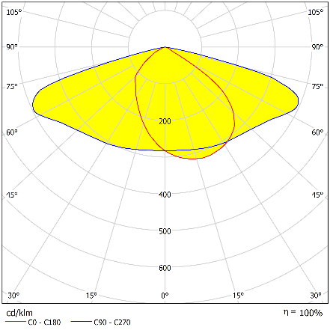
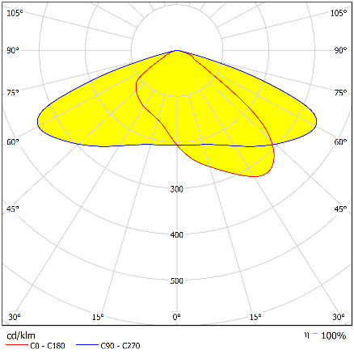
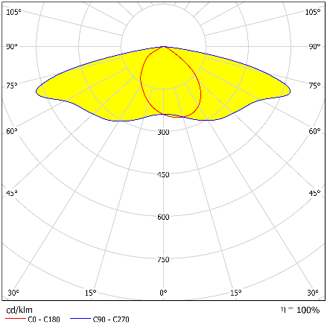

曲线配光：
Light Distributions:
618-5050-T2S
831-5050-T2S
711-5050-T2S
710-5050-T2M
Note: The pictures are only the references of typical light distribution type, and the specific parameters shall be subject to the actual IES of the product.

Slide 5

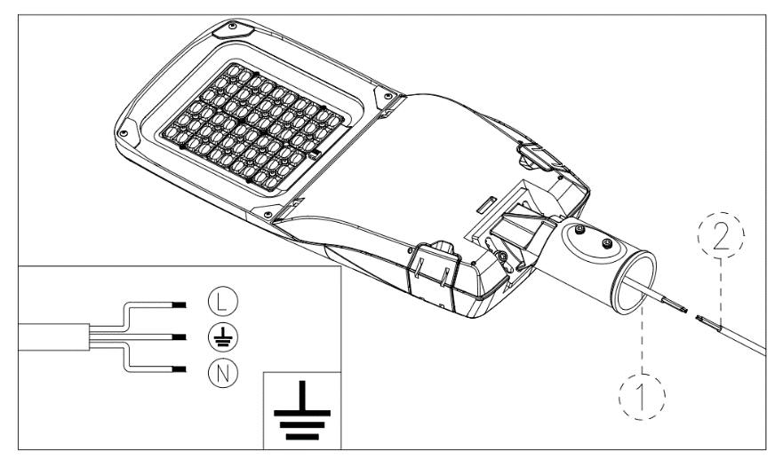
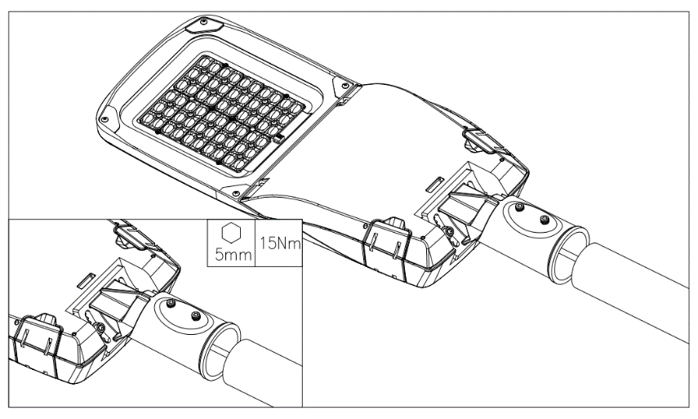
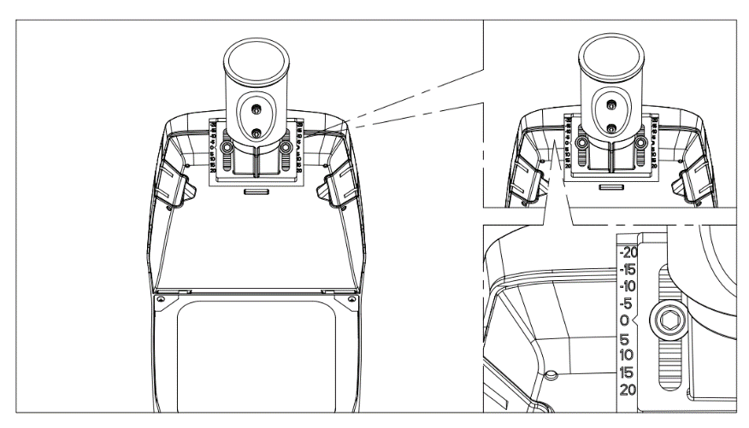
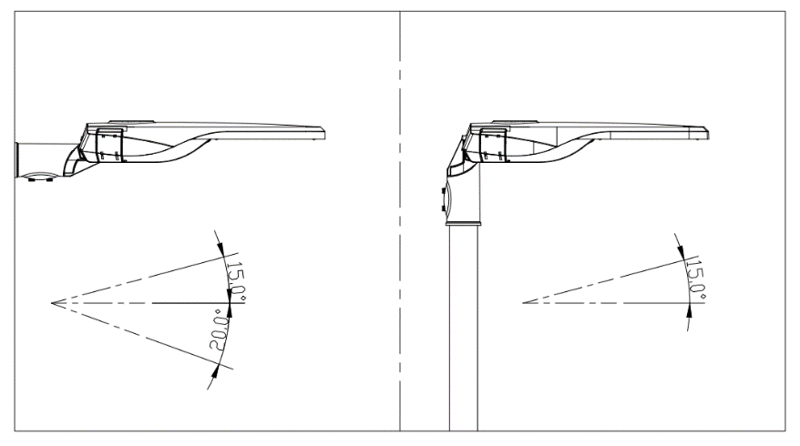
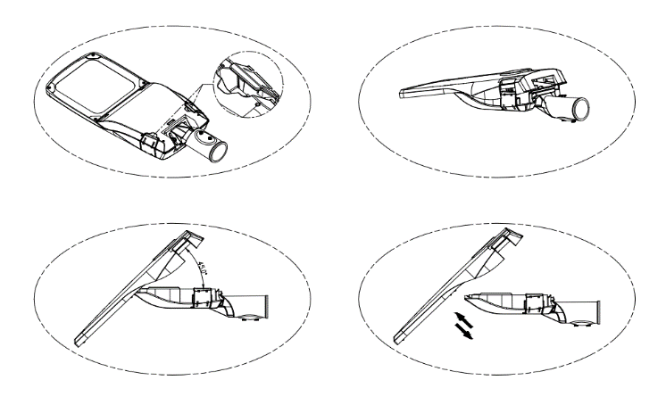
Installation Diagram:
吊杆安装示意图：
1. Wire the power cables of the luminaire and the pole according to the picture below: L(BRN) live line, N (BLU) neutral line,
(YG/GRN) ground line) , making the connection waterproof.
2. Insert the cantilevered arm of lamp pole into the lamp, and then tighten 2pcs M10 screws.
3. Loosen the two screws as shown in the picture; adjust the pointer of the angle adjuster to the required angle value ,then tighten the two M8 screws
4. Horizontal and vertical installation are optional and the minimum angle adjustment is 5 °.
5. Open the fasteners as shown in the picture; Open the cover 45 ° and pull out the upper cover component to maintain it

Slide 6


Maintenance:
Keep the luminaire in clean and good maintenance to ensure long lifespan and safety use.
Wipe the luminaire with soft cloth dipped with soapy water (squeeze the water out first), and then make it clean and dry with a new cloth;
Do not use volatile chemical liquids such as gasoline, alcohol or insecticides to clean the luminaire, otherwise damage occurs.
Cautions:
维护保养：
Make sure safe and complete installation before power on;
Do not mount the luminaire onto ordinary combustible materials directly in any circumstances;
Do not cover the luminaire with any objects;
Do not use the product in a closed environment;
The maintenance of the luminaire must be done by professionals;
The external wiring of the luminaire is Y-shaped. If damaged, shall be replaced with wires provided by the original manufacturer or its service team;
The light source, if damaged, shall be replaced with chips provided by the manufacturer or service team.
Warning, danger of electric shock
Statement: The luminaire complies with the non-hazardous requirements in the photobiological safety standard IEC 62471:2006;
Product specifications are subject to change without notice.
HQ Address: 112 Yongfu Rd., Qiaotou Village, Fuyong Town, Baoan District, Shenzhen 518103 China.
Manufacturing Base: Unilumin Industrial Park, 6th Lanjing North Road, Pingshan District, Shenzhen, China.
TEL：+86-0755-29918999
FAX：+86-0755-29912092
www.unilumin.com
www.unilumin-lighting.com

